Slide 1
Data Structures

Slide 2
Agenda
Deletion in Linked List
Find the Middle Element
Merge Two Sorted LL
Array vs Linked List
Reverse a LL
For practice:
https://www.geeksforgeeks.org/must-do-coding-questions-for-companies-like-amazon-microsoft-adobe/

Slide 3
Deletion in Linked List
Deletion:
Delete the complete Linked List
Deletion from Head
Deletion from End
Deletion from nth position

Slide 4
Deletion in Linked List

Slide 5
Find the Middle Element (second in case of even)

Slide 6
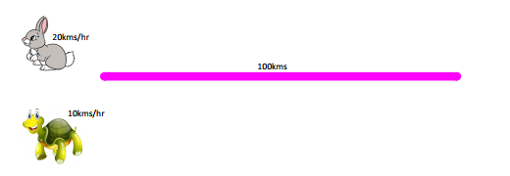
Find the Middle Element (second in case of even)

Slide 7
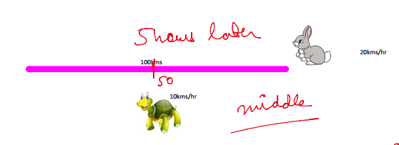
Find the Middle Element (second in case of even)

Slide 8
Find the Middle Element (second in case of even)

Slide 9
Problems:
https://practice.geeksforgeeks.org/problems/finding-middle-element-in-a-linked-list/1/
https://practice.geeksforgeeks.org/problems/nth-node-from-end-of-linked-list/1

Slide 10
Merge Two Sorted LL
Try this with recursion

Slide 11
Array vs Linked List
https://www.geeksforgeeks.org/linked-list-vs-array/
https://www.javatpoint.com/ds-array-vs-linked-list

Slide 12

Reverse a LL / k Groups

Slide 13
Reverse a LL / k Groups
H.W: Try Using Recursion

Slide 14
THANK YOU

